Slide 1
Seismic Slice Crack/Fault Detection and Modeling Based on Structural Tensor(ST) and Hessian Matrix
Speaker: Liao.L
Tutor: Zhengming Peng & Bingjie Tao
IDIPLAB · UESTC

Slide 2
CONTENTS
Introduction
Method
Implementation
Conclusion

Slide 3
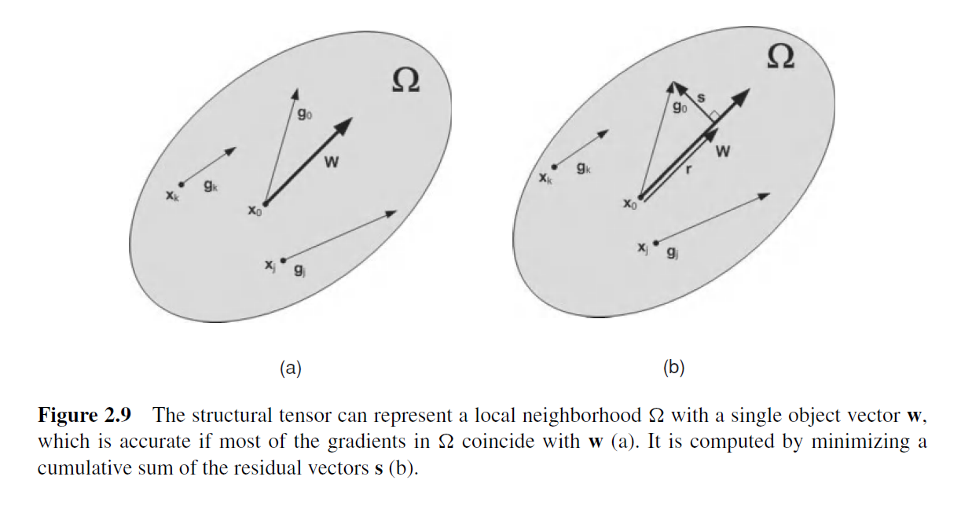
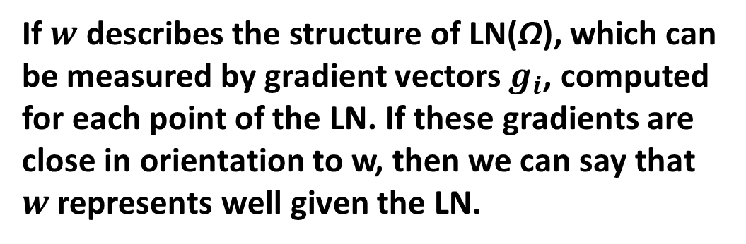
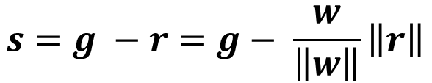
Introduction
1.1 Structural Tensor(ST)
The idea of the structural tensor (ST) in an L-dimensional space is to find regular structures in local neighborhoods(LN) of each point of this space.
L = 2
If $w$ describes the structure of LN(Ω), which can be measured by gradient vectors $g_{i}$, computed for each point of the LN. If these gradients are close in orientation to w, then we can say that $w$ represents well given the LN.
$$s=g −r=g− \frac{w}{\left\|w\right\|}\left\|r\right\|$$

Slide 4
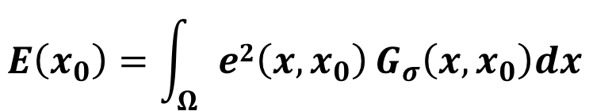
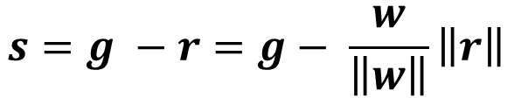
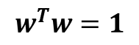
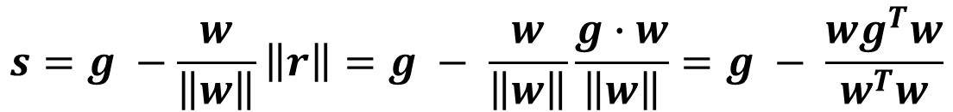
Introduction
1.1 Structural Tensor(ST)
$$s=g −r=g− \frac{w}{\left\|w\right\|}\left\|r\right\|$$
$g∙w= \left\|g\right\| \left\|w\right\| cosα= \left\|g\right\| \left\|w\right\|$ $\left\|r\right\|/\left\|g\right\|$ = $\left\|w\right\| \left\|r\right\|$
$$s=g −\frac{w}{\left\|w\right\|}\left\|r\right\|=g − \frac{w}{\left\|w\right\|}\frac{g∙w}{\left\|w\right\|}=g − \frac{wg^{T}w}{w^{T}w}$$
Assuming
$$w^{T}w=1$$
$$e\left(x,x_{0}\right)= \left\|s\right\|=\left\|g(x) −w\left(x_{0}\right)g^{T}\left(x\right)w\left(x_{0}\right)\right\|$$
$$E\left(x_{0}\right)=\int_{Ω}{e2\left(x,x_{0}\right)}G_{σ}\left(x,x_{0}\right)dx$$

Slide 5
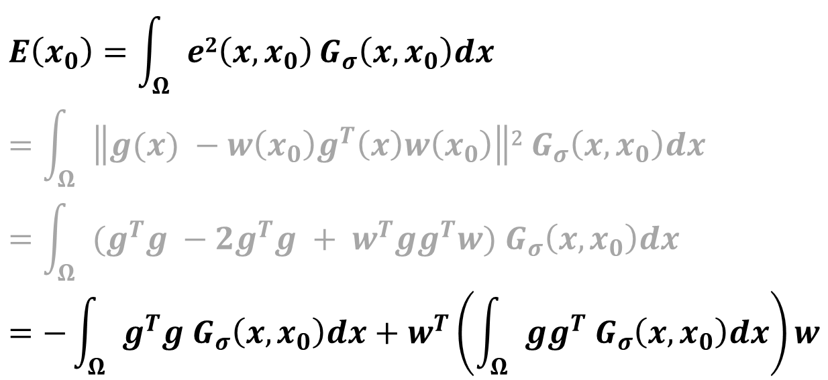
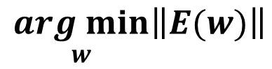
Introduction
1.1 Structural Tensor(ST)
$$E\left(x_{0}\right)=\int_{Ω}{e2\left(x,x_{0}\right)}G_{σ}\left(x,x_{0}\right)dx \\ =\int_{Ω}{\left\|g(x) −w\left(x_{0}\right)g^{T}\left(x\right)w\left(x_{0}\right)\right\|\text{2}{ G}_{σ}\left(x,x_{0}\right)dx} \\ =\int_{Ω}{(g^{T}g −2g^{T}g + w^{T}gg^{T}w){ G}_{σ}\left(x,x_{0}\right)dx} \\ =−\int_{Ω}{g^{T}g{ G}_{σ}\left(x,x_{0}\right)dx}+w^{T}\left(\int_{Ω}{gg^{T}{ G}_{σ}\left(x,x_{0}\right)dx}\right)w$$
$$\underset{w}{arg min}\left\|E(w)\right\|$$

Slide 6
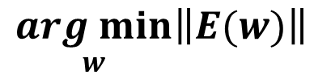
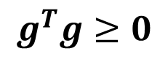
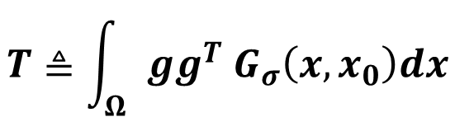
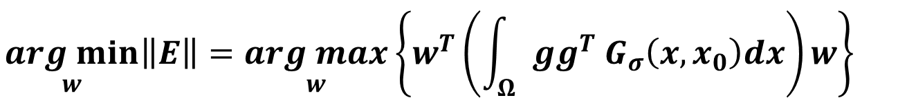
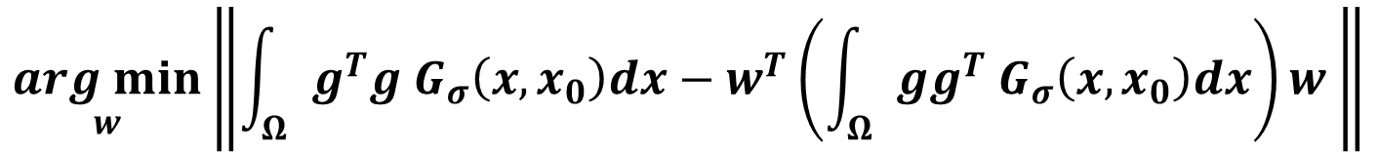
Introduction
1.1 Structural Tensor(ST)
$$\underset{w}{arg min}\left\|E(w)\right\|$$
$$\underset{w}{arg min}\left\|\int_{Ω}{g^{T}g{ G}_{σ}\left(x,x_{0}\right)dx}−w^{T}\left(\int_{Ω}{gg^{T}{ G}_{σ}\left(x,x_{0}\right)dx}\right)w \right\|$$
$$g^{T}g≥0$$
$$\underset{w}{arg min}\left\|E\right\|=\underset{w}{arg max}{{\left\{w^{T}\left(\int_{Ω}{gg^{T}{ G}_{σ}\left(x,x_{0}\right)dx}\right)w\right\} }^{}}$$
$$T≜\int_{Ω}{gg^{T}{ G}_{σ}\left(x,x_{0}\right)dx}$$

Slide 7
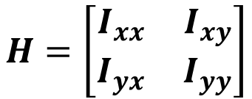
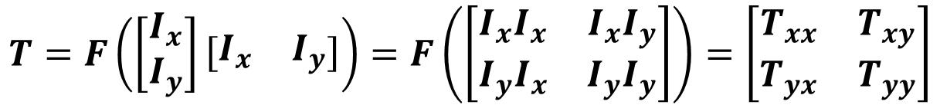
Introduction
1.1 Structural Tensor(ST)
$$T=F\left(\left[\begin{matrix}I_{x} \\ I_{y}\end{matrix}\right]\left[\begin{matrix}I_{x} & I_{y}\end{matrix}\right]\right)=F\left(\left[\begin{matrix}I_{x}I_{x} & I_{x}I_{y} \\ I_{y}I_{x} & I_{y}I_{y}\end{matrix}\right]\right)=\left[\begin{matrix}T_{xx} & T_{xy} \\ T_{yx} & T_{yy}\end{matrix}\right]$$
$$H=\left[\begin{matrix}I_{xx} & I_{xy} \\ I_{yx} & I_{yy}\end{matrix}\right]$$
$$y=f\left(x+∆x\right)≈f\left(x\right)+∇{f\left(x\right)}^{T}∆x+\frac{1}{2!}∆x^{T}H(x)∆x$$

Slide 8
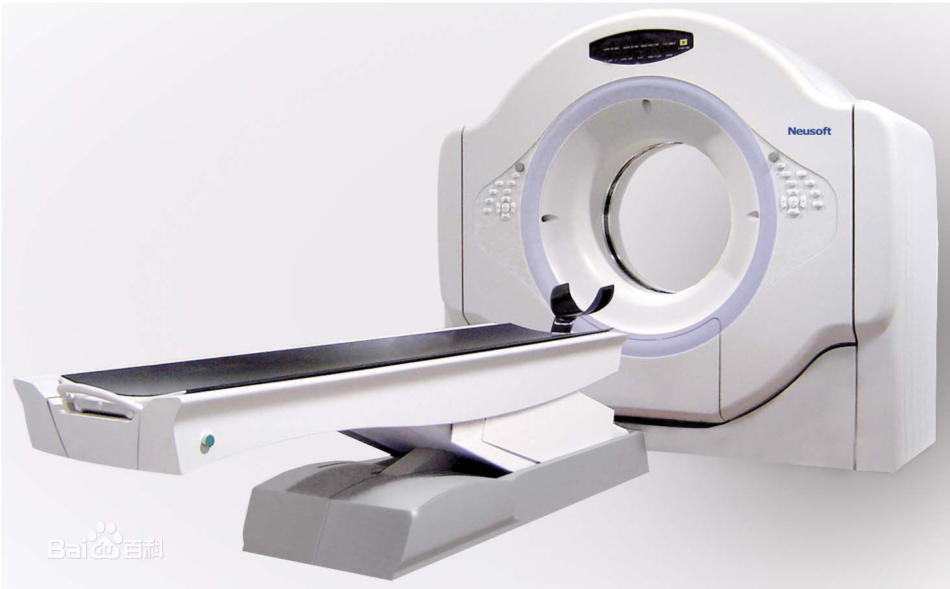
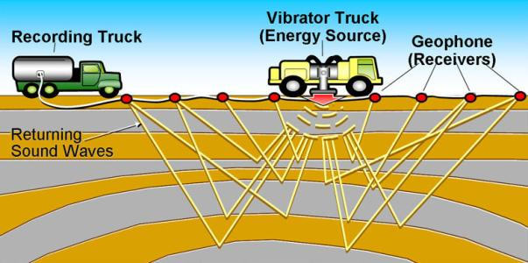
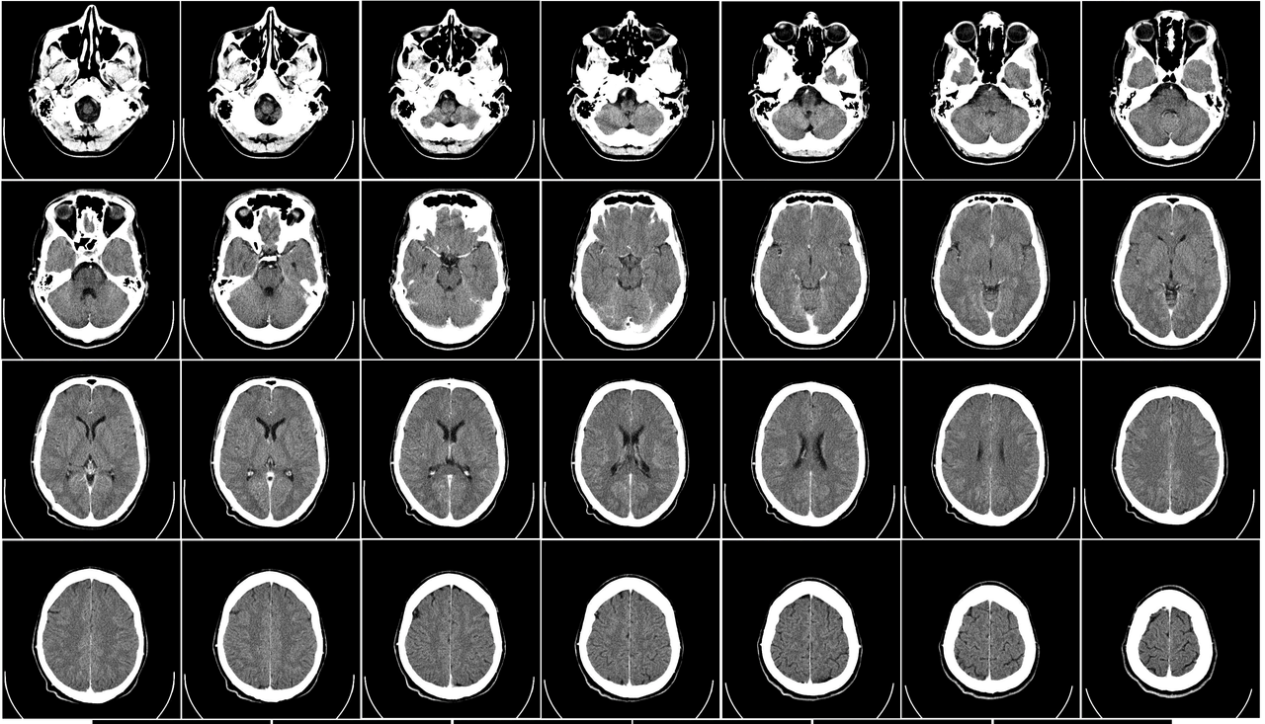
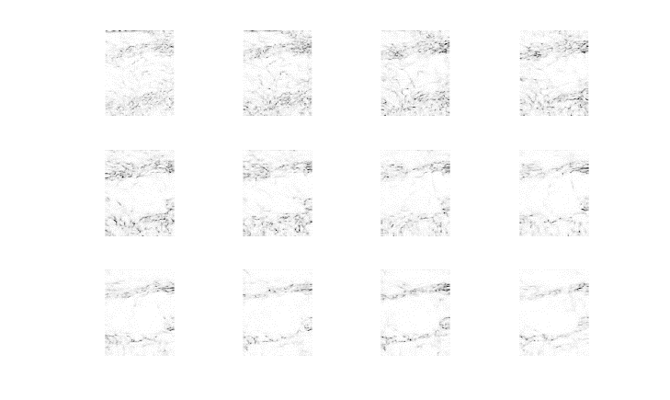
Introduction
1.2 Seismic Slices
Do CT for earth
CT Slices
Seismic Slices

Slide 9
CONTENTS
Introduction
Method
Implementation
Conclusion

Slide 10
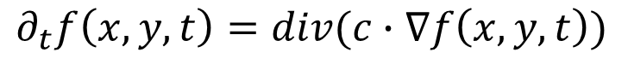
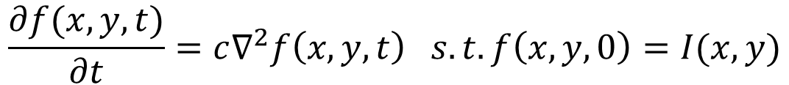
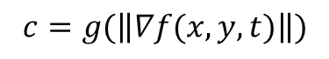
Method
2.1 Anisotropic Diffusion Filtering(AD Filtering)
[1] Perona P, Malik J. Scale-Space and Edge Detection Using Anisotropic Diffusion[J]. IEEE Transactions on Pattern Analysis & Machine Intelligence, 2002, 12(7):629-639.
Ideal: look images as heat field.
Image processing is modeled by the heat conduction diffusion equation.
$$\frac{∂f(x,y,t)}{∂t}=c∇^{2}f\left(x,y,t\right) s.t. f\left(x,y,0\right)=I(x,y)$$
$$∂_{t}f\left(x,y,t\right)=div(c∙∇f\left(x,y,t\right))$$
$$make c to dependent on the signal gradient [1]$$
$$c=g(\left\|∇f(x,y,t)\right\|)$$
$$∂_{t}f\left(x,y,t\right)=div(g(\left\|∇f(x,y,t)\right\|)∙∇f\left(x,y,t\right))$$

Slide 11
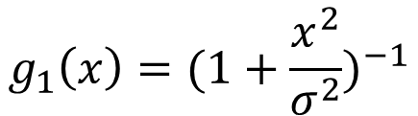
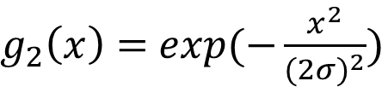
Method
2.1 Anisotropic Diffusion Filtering(AD Filtering)
$$∂_{t}f\left(x,y,t\right)=div(g(\left\|∇f(x,y,t)\right\|)∙∇f\left(x,y,t\right))$$
g for a large argument should approach zero to stop smoothing in this direction.
$$g_{1}\left(x\right)={(1+\frac{x^{2}}{σ^{2}})}^{−1}$$
$g_{2}\left(x\right)=$ $exp(−\frac{x^{2}}{{(2σ)}^{2}})$

Slide 12
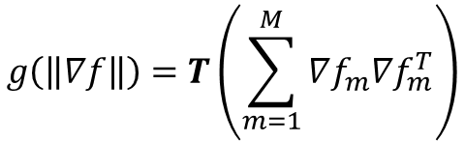
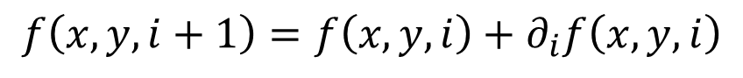
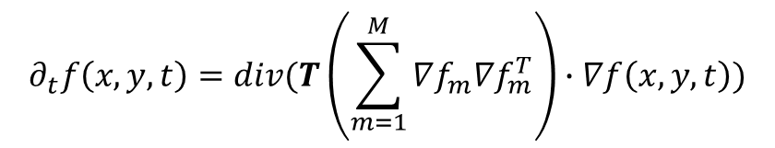
Method
2.1 Anisotropic Diffusion Filtering(AD Filtering)
$$∂_{t}f\left(x,y,t\right)=div(g(\left\|∇f(x,y,t)\right\|)∙∇f\left(x,y,t\right))$$
The above equation is nonlinear but still isotropic which is an effect of application of the scalar function g.
Based on ST
$$g\left(\left\|∇f\right\|\right)=T\left(\sum_{m=1}^{M}{∇f_{m}∇f_{m}^{T}}\right)$$
$$∂_{t}f\left(x,y,t\right)=div(T\left(\sum_{m=1}^{M}{∇f_{m}∇f_{m}^{T}}\right)∙∇f\left(x,y,t\right))$$
$$f\left(x,y,i+1\right)=f\left(x,y,i\right)+∂_{i}f\left(x,y,i\right)$$

Slide 13
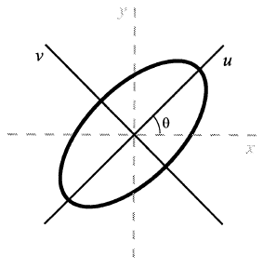
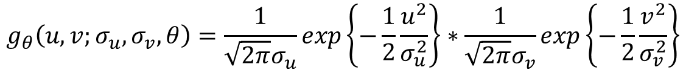
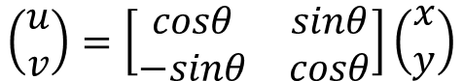
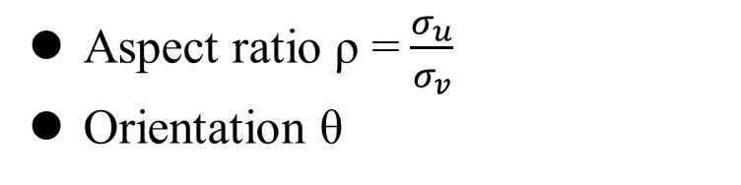
Method
2.2 Direction Constrained Gaussian Filtering (DCG Filtering)
$$g_{θ}\left(u,v;σ_{u},σ_{v},θ\right)=\frac{1}{\sqrt{2π}σ_{u}}exp\left\{−\frac{1}{2}\frac{u^{2}}{σ_{u}^{2}}\right\}∗\frac{1}{\sqrt{2π}σ_{v}}exp\left\{−\frac{1}{2}\frac{v^{2}}{σ_{v}^{2}}\right\}$$
$$\left(\begin{matrix}u \\ v\end{matrix}\right)=\left[\begin{matrix}cosθ & sinθ \\ −sinθ & cosθ\end{matrix}\right]\left(\begin{matrix}x \\ y\end{matrix}\right)$$
Aspect ratio ρ =$\frac{σ_{u}}{σ_{v}}$
Orientation θ
ρ and θ control the direction of Gaussian filtering

Slide 14
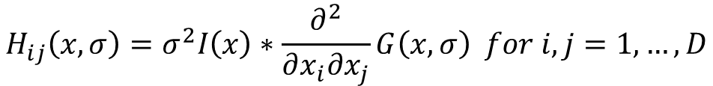
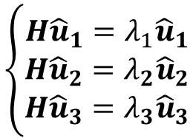
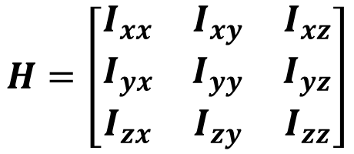
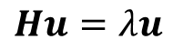
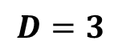
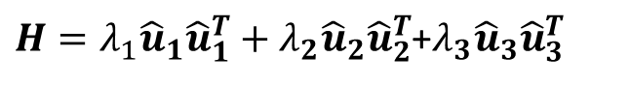
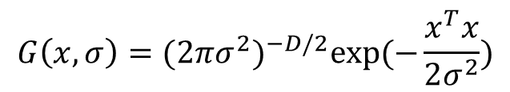
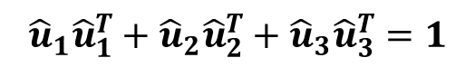
Method
2.3 Jerman Enhancement
$$H=\left[\begin{matrix}I_{xx} & I_{xy} & I_{xz} \\ I_{yx} & I_{yy} & I_{yz} \\ I_{zx} & I_{zy} & I_{zz}\end{matrix}\right]$$
$$H_{ij}\left(x,σ\right)=σ^{2}I\left(x\right)∗\frac{∂^{2}}{∂x_{i}∂x_{j}}G\left(x,σ\right) for i,j=1,…,D$$
$$G\left(x,σ\right)={(2πσ^{2})}^{−D/2}exp⁡(−\frac{x^{T}x}{2σ^{2}})$$
$$D=3$$
$$\left\{\begin{aligned}H{\hat{u}}_{1}=λ_{1}{\hat{u}}_{1} \\ H{\hat{u}}_{2}=λ_{2}{\hat{u}}_{2} \\ H{\hat{u}}_{3}=λ_{3}{\hat{u}}_{3}\end{aligned}\right.$$
$$Hu=λu$$
$${\hat{u}}_{1}{\hat{u}}_{1}^{T}+{\hat{u}}_{2}{\hat{u}}_{2}^{T}+{\hat{u}}_{3}{\hat{u}}_{3}^{T}=1$$
$H{(\hat{u}}_{1}{\hat{u}}_{1}^{T}+{\hat{u}}_{2}{\hat{u}}_{2}^{T}+{\hat{u}}_{3}{\hat{u}}_{3}^{T})=λ_{1}{\hat{u}}_{1}{\hat{u}}_{1}^{T}+λ_{2}{\hat{u}}_{2}{\hat{u}}_{2}^{T}$+$λ_{3}{\hat{u}}_{3}{\hat{u}}_{3}^{T}$
$H=λ_{1}{\hat{u}}_{1}{\hat{u}}_{1}^{T}+λ_{2}{\hat{u}}_{2}{\hat{u}}_{2}^{T}$+$λ_{3}{\hat{u}}_{3}{\hat{u}}_{3}^{T}$

Slide 15
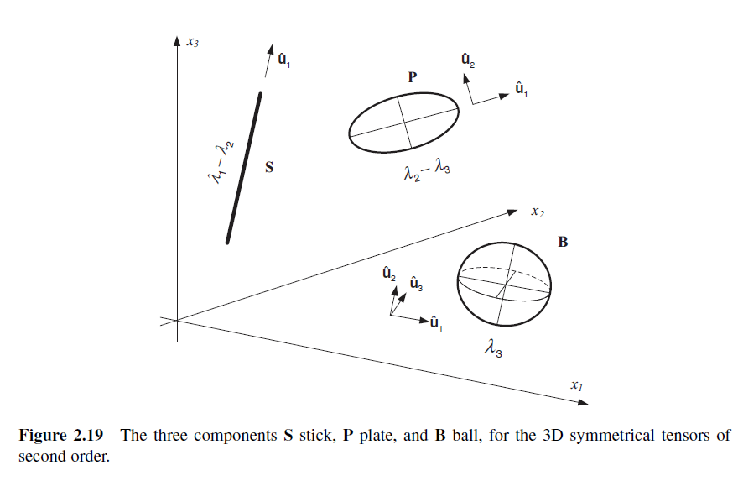
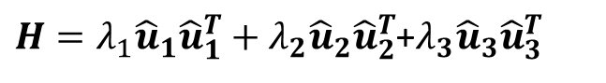
Method
2.3 Jerman Enhancement
$H=λ_{1}{\hat{u}}_{1}{\hat{u}}_{1}^{T}+λ_{2}{\hat{u}}_{2}{\hat{u}}_{2}^{T}$+$λ_{3}{\hat{u}}_{3}{\hat{u}}_{3}^{T}$
$H={(λ}_{1}−{λ_{2})\hat{u}}_{1}{\hat{u}}_{1}^{T}+{(λ}_{2}−λ_{3}){({\hat{u}}_{1}{\hat{u}}_{1}^{T}+\hat{u}}_{2}{\hat{u}}_{2}^{T})$+$λ_{3}{(\hat{u}}_{1}{\hat{u}}_{1}^{T}+{\hat{u}}_{2}{\hat{u}}_{2}^{T}+{\hat{u}}_{3}{\hat{u}}_{3}^{T})$
S
P
B
S, P and B are called stick, plate, and ball (sphere) tensors, respectively.

Slide 16
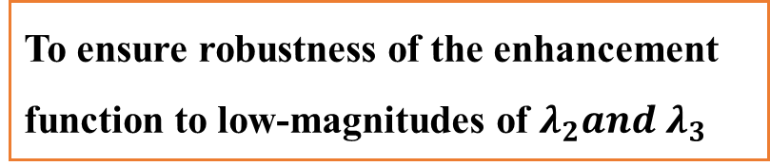
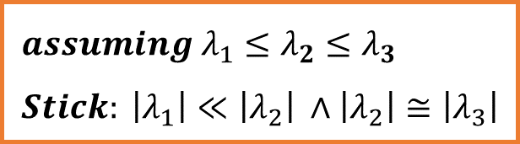
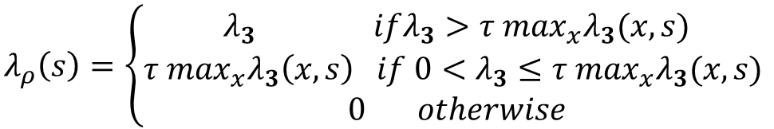
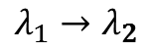
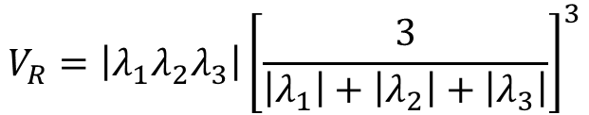
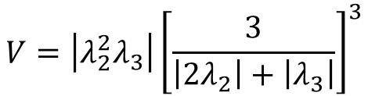
Method
2.3 Jerman Enhancement
$$assuming λ_{1}≤λ_{2}≤λ_{3} \\ Stick: \left|λ_{1}\right|≪\left|λ_{2}\right| ∧\left|λ_{2}\right|≅\left|λ_{3}\right|$$
A measure based on the ratio of eigenvalues, that is otherwise used for the detection of nearly spherical diffusion tensors.
To ensure robustness of the enhancement function to low-magnitudes of $λ_{2}and λ_{3}$
$$V_{R}=\left|λ_{1}λ_{2}λ_{3}\right|{\left[\frac{3}{\left|λ_{1}\right|+\left|λ_{2}\right|+\left|λ_{3}\right|}\right]}^{3}$$
$$λ_{1}→λ_{2}$$
$$λ_{ρ}\left(s\right)=\left\{\begin{aligned}λ_{3} ifλ_{3}>τ\max_{x}λ_{3}(x,s) \\ τ \max_{x}λ_{3}\left(x,s\right) if 0<λ_{3}≤τ\max_{x}λ_{3}(x,s) \\ 0 otherwise\end{aligned}\right.$$
$$V=\left|λ_{2}^{2}λ_{3}\right|{\left[\frac{3}{\left|{2λ}_{2}\right|+\left|λ_{3}\right|}\right]}^{3}$$
Jerman T, Pernuš F, Likar B, et al. Enhancement of vascular structures in 3D and 2D angiographic images[J]. IEEE transactions on medical imaging, 2016, 35(9): 2107-2118.

Slide 17
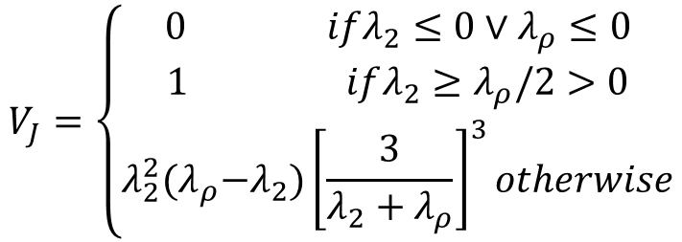
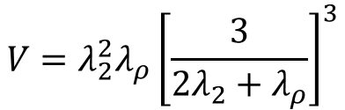




Method
$$assuming λ_{1}≤λ_{2}≤λ_{3} \\ Stick: \left|λ_{1}\right|≪\left|λ_{2}\right| ∧\left|λ_{2}\right|≅\left|λ_{3}\right|$$
2.3 Jerman Enhancement
$$V=λ_{2}^{2}λ_{ρ}{\left[\frac{3}{{2λ}_{2}+λ_{ρ}}\right]}^{3}$$
$$V=\left|λ_{2}^{2}λ_{3}\right|{\left[\frac{3}{\left|{2λ}_{2}\right|+\left|λ_{3}\right|}\right]}^{3}$$
$$λ_{ρ}→(λ_{ρ}−λ_{2})$$
$$V_{J}=\left\{\begin{aligned}0 ifλ_{2}≤0∨λ_{ρ}≤0 \\ 1 ifλ_{2}≥λ_{ρ}/2>0 \\ λ_{2}^{2}{(λ}_{ρ}−λ_{2}){\left[\frac{3}{λ_{2}+λ_{ρ}}\right]}^{3}otherwise\end{aligned}\right.$$
$$λ_{ρ}\left(s\right)=\left\{\begin{aligned}λ_{3} ifλ_{3}>τ\max_{x}λ_{3}(x,s) \\ τ \max_{x}λ_{3}\left(x,s\right) if 0<λ_{3}≤τ\max_{x}λ_{3}(x,s) \\ 0 otherwise\end{aligned}\right.$$

Slide 18




Method
2.3 Jerman Enhancement
$$V_{J}=\left\{\begin{aligned}0 ifλ_{2}≤0∨λ_{ρ}≤0 \\ 1 ifλ_{2}≥λ_{ρ}/2>0 \\ λ_{2}^{2}{(λ}_{ρ}−λ_{2}){\left[\frac{3}{λ_{2}+λ_{ρ}}\right]}^{3}otherwise\end{aligned}\right.$$
$$H_{ij}\left(x,σ\right)=σ^{2}I\left(x\right)∗\frac{∂^{2}}{∂x_{i}∂x_{j}}G\left(x,σ\right) for i,j=1,…,D$$
$$G\left(x,σ\right)={(2πσ^{2})}^{−D/2}\exp\left(−\frac{x^{T}x}{2σ^{2}}\right)=G_{θ}\left(u,v;σ_{u},σ_{v},θ\right)$$
$$Algorithm$$
Initialization parameters: $σ_{u},{ρ, σ}_{v}= ρσ_{u},θ, and τ$
In each LN:
Compute ${\frac{∂^{2}}{∂x_{i}∂x_{j}}G}_{θ}\left(u,v;σ_{u},σ_{v},θ\right)$
$H_{ij}\left(u,v;σ_{u},σ_{v},θ\right)={(σ}_{u}^{2}+σ_{v}^{2})I\left(x\right)∗{\frac{∂^{2}}{∂x_{i}∂x_{j}}G}_{θ}\left(u,v;σ_{u},σ_{v},θ\right) for i,j=1,…,D$
$Compute λ_{1}, λ_{2}, λ_{3}$ ($λ_{1}≤λ_{2}≤λ_{3}$) from $H_{ij}\left(u,v;σ_{u},σ_{v},θ\right)$
$λ_{ρ}\left(s\right)=\left\{\begin{aligned}λ_{3} ifλ_{3}>τ\max_{x}λ_{3}(x,s) \\ τ \max_{x}λ_{3}\left(x,s\right) if 0<λ_{3}≤τ\max_{x}λ_{3}(x,s) \\ 0 otherwise\end{aligned}\right.$
$return V_{J}$

Slide 19


Method
2.4 Steger Ridge Detection
Edges
Abrupt change in the intensity of pixels.
Discontinuity in image brightness or contrast.
Usually edges occur on the boundary of two regions.

Slide 20









Method
Steger C. An unbiased detector of curvilinear structures[J]. IEEE Transactions on Pattern Analysis & Machine Intelligence, 2002, 20(2):113-125.
2.4 Steger Ridge Detection
$$H=\left[\begin{matrix}I_{xx} & I_{xy} \\ I_{yx} & I_{yy}\end{matrix}\right]$$
$$λ_{1}≤λ_{2}$$
$$Hn=λ_{2}n {s.t.\left\|\left(n_{x},n_{y}\right)\right\|}_{2}=1$$
$$p\left(x\right)=r+r^{′}x+\frac{1}{2}r^{′′}x^{2}$$
$$p\left(x,y\right)=r+r_{x}x+r_{y}y+\frac{1}{2}(r_{xx}x^{2}+2r_{xy}xy+r_{yy}y^{2})$$
The position of the ridge line, must be $p^{′}\left(x\right)=0$
$$x=tn_{x},y=tn_{y}$$
$$t=−\frac{r_{x}n_{x}+r_{y}n_{y}}{r_{xx}{n_{x}}^{2}+2r_{xy}n_{x}n_{y}+r_{yy}{n_{y}}^{2}}$$
$$x=−\frac{r^{′}}{r^{′′}}$$
$$\left(p_{x},p_{y}\right)=(tn_{x},tn_{y})$$
Sub-pixel
$$\left(p_{x},p_{y}\right)∈\left[−\frac{1}{2},\frac{1}{2}\right]×\left[−\frac{1}{2},\frac{1}{2}\right]is required in order for a point to be declared a line point.$$

Slide 21
CONTENTS
Introduction
Method
Implementation
Conclusion

Slide 22
Implementation
3.0 Main Structure
Main Steps
Smoothing: Noise Reduction
Enhancement: Ridge Sharpening
Detection: Which to discard and which to maintain
Modeling: 2D converted to 3D

Slide 23





Introduction
3.1 Implementation – AD Filtering
iteration = 100
iteration = 200
iteration = 400
iteration = 1000

Slide 24

Implementation
3.1 Implementation – AD Filtering
iteration = 200
Gaussian filter

Slide 25



Implementation
3.2 Implementation – Jerman Filtering
iteration = 200
$$ρ=3, θ=60$$

Slide 26





Implementation
3.3 Implementation – Steger Ridge Detection
$$ρ=3, θ=60$$
sigma=5
sigma=6

Slide 27



Implementation
3.3 Implementation – Modeling

Slide 28
CONTENTS
Introduction
Method
Implementation
Conclusion

Slide 29
Conclusion
4 conclusion
The advantages :
Less parameters
No binarization required
Adapt to low SNR data
High accuracy
The innovations:
Using hessian matrix to process seismic coherence slices
Introducing DCG filtering to Jerman filtering

Slide 30
Extra content

Slide 31


Conclusion
E1 deburring in skeleton BW image
https://github.com/LiaoLIDIP/Deburring

Slide 32




Conclusion
E2 deep learning

Slide 33

Conclusion
E2 deep learning

Slide 34
THANKS
https://github.com/LiaoLIDIP/Report-IDIPLab

Slide 36







Method
2.3 Jerman Enhancement
$$assuming λ_{1}≤λ_{2}≤λ_{3}$$
$${Frangi: V}_{F}=\left(1−exp⁡(−\frac{R_{A}^{2}}{2α^{2}})\right)\left(1−exp⁡(−\frac{S_{3}^{2}}{2κ^{2}})\right)$$
$$where S_{3}=\sqrt{λ_{1}^{2}+λ_{2}^{2}+λ_{3}^{2}} , R_{A}=λ_{2}/λ_{3}$$
$${Sato: V}_{S}=\left|λ_{3}\right|{\left(\frac{λ_{2}}{λ_{3}}\right)}^{γ}$$
$${Erdt: V}_{E}=K\left|{−λ_{2}−λ}_{3}\right|, \\ where K=1−\left|{λ_{2}−λ}_{3}\right|/\left|{λ_{2}+λ}_{3}\right|$$
$${Zhou: V}_{Z}=\frac{\left|{λ_{2}+λ}_{3}\right|}{2}×exp⁡\left(−\left|\frac{\left|λ_{3}\right|}{S_{3}}−c\right|\right) \\ where c is between\frac{1}{\sqrt{3}}and\frac{1}{\sqrt{2}}$$
$${Li: V}_{L}=\left|λ_{2}\right|×\frac{λ_{2}}{λ_{3}}$$

Slide 37

Method
2.3 Jerman Enhancement

